Slide 1

Client and Server in HTTP

Slide 2
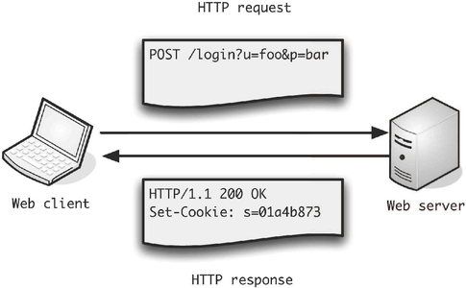

Slide 3
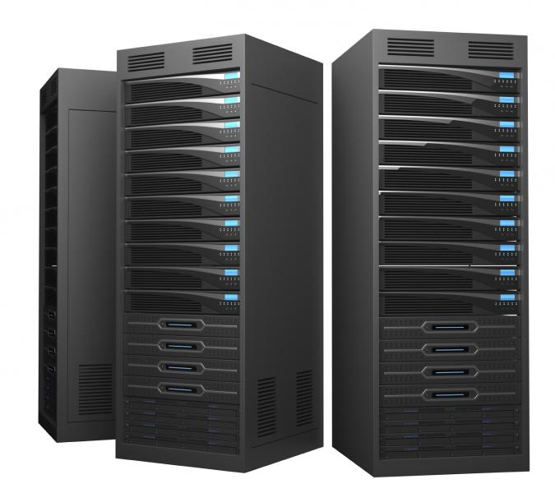


What is a server?
Any computer that can accept and respond to an HTTP request.

Slide 4

What is a client?
Any computer that can make an HTTP request.
Usually has a web browser installed, but it's not necessary. There are other ways to make an HTTP request (e.g. command line)

Slide 5
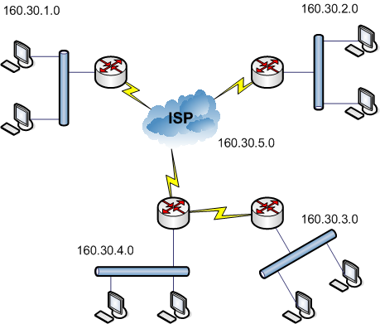
The trip from client to server isn't a straight line though...

Slide 6
Internet Protocol (IP) Address
All clients and servers have an IP address
4(or 6) period separated numbers ranging from 0 to 255.
Numerical address required for routers and internet services.
Let's try going to this address: http://66.135.216.190

Slide 7
Domain Name System (DNS)
Servers provide websites, but we also need servers that provide IP address for corresponding domain names.
When you type “www.ebay.com” and hit enter, the request goes to your router.
You router has the IP address of a DNS server, usually provided by your ISP.
This DNS server contacts another DNS server (root DNS server) which responds with an address to another DNS server (responsible for .com) which responds with an address to another DNS server that knows the IP address for “www.ebay.com”.

Slide 8
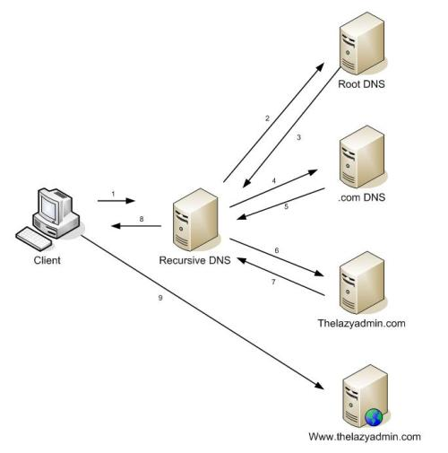
DNS Resolution
You can use the nslookup command to find an IP address in the command line.

Slide 9
Hypertext Transfer Protocol (HTTP)
Structured text with links to other nodes of text.
This is the foundation of the web!
Media on the internet is requested and sent via HTTP.

Slide 10
Parts of an HTTP Request
URI
Verb:
GET
POST
PUT
DELETE
HEAD
OPTIONS
PATCH
MOVE
PURGE
LOCK
SEARCH
CONNECT
TRACE
SUBSCRIBE
...
GET
http://ww.ebay.com
Accept: text/html,
Accept-Language: en-US,
User-Agent: Chrome 46.0.2,
Cookie: 8tD%d77&TOf…
Headers:
Who am I?
What do I want?
Where am I?
etc...

Slide 11
Parts of an HTTP Request
POST
http://ww.ebay.com/orders
Accept: text/html,
Accept-Language: en-US,
User-Agent: Chrome 46.0.2,
Cookie: 8tD%d77&TOf…
id: 438243463,
quantity: 2,
Body:
info to be posted

Slide 12

Parts of an HTTP Response
Headers (again)
Content-Type: text/html,
Content-Language: en-US,
Date: Thu, 10 Dec 2015 22:37:29 GMT,
Set-Cookie: 8tD%d77&TOf…
Status:
200-299 OK
300-399 additional action
400-499 client error
500-599 server error
<html>
<head>…</head>
<body>
<h1> Give me money </h1>
<div>
<p> Here are products </p>
</div>
</body>
</html>
Body:
the actual stuff you'll see

Slide 13
What visiting a page actually looks like
GET ebay.com
{ Accept: text/html }
200
{ Content-Type: text/html }
<html>bunch of stuff</html>

Slide 14
What visiting a page actually looks like
<html>
…
<link href=”/style.css” />
…
GET ebay.com/style.css
{ Accept: text/css }
200
{ Content-Type: text/css }
.container { margin: 0 auto; }

Slide 15
What visiting a page actually looks like
<html>
…
<link href=”/style.css” />
…
<script src=”/main.js” />
</html>
GET ebay.com/main.js
{ Accept: application/javascript }
200
{ Content-Type: js }
console.log('hello world');

Slide 16

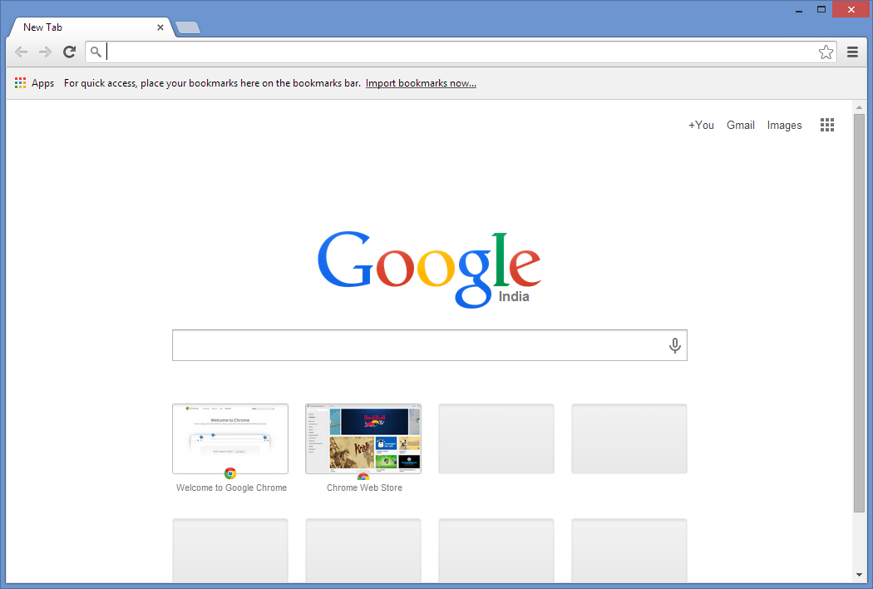





Technologies on Client and Server

